Slide 1

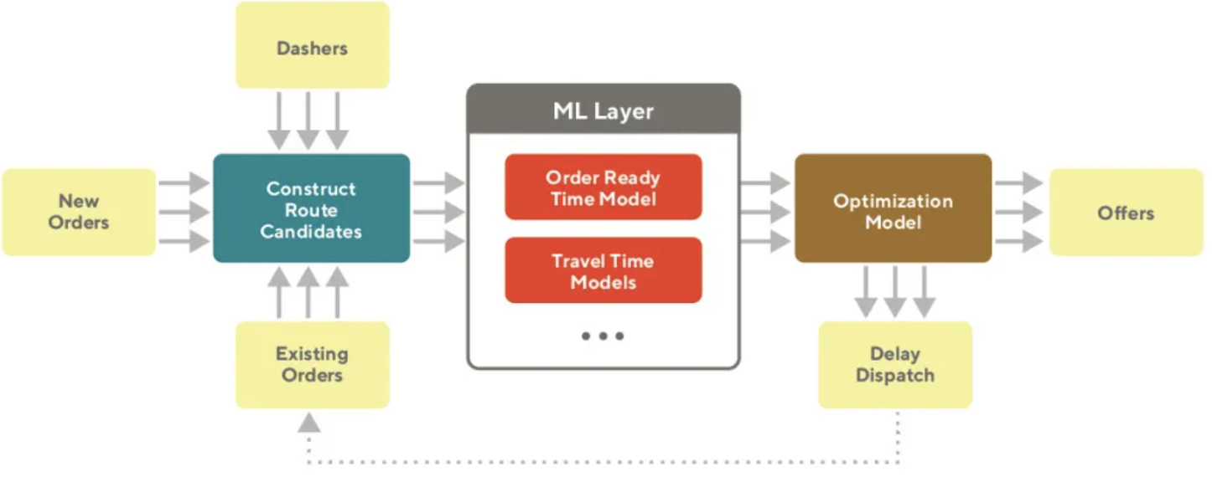
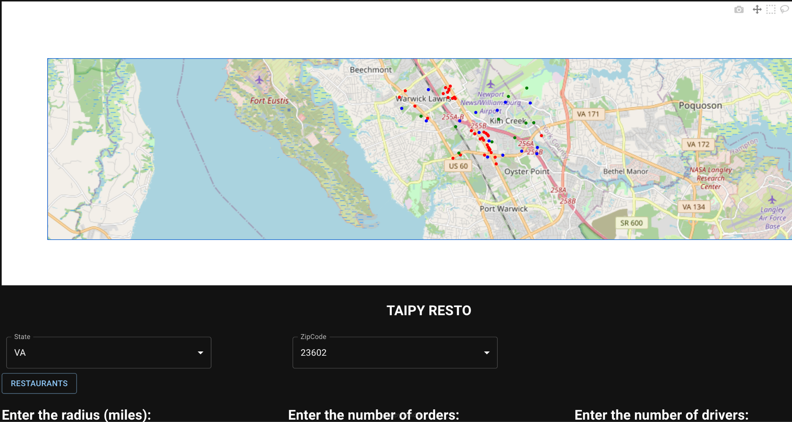
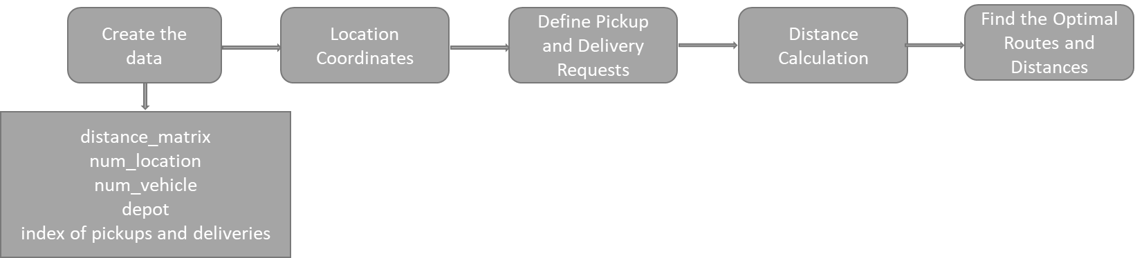
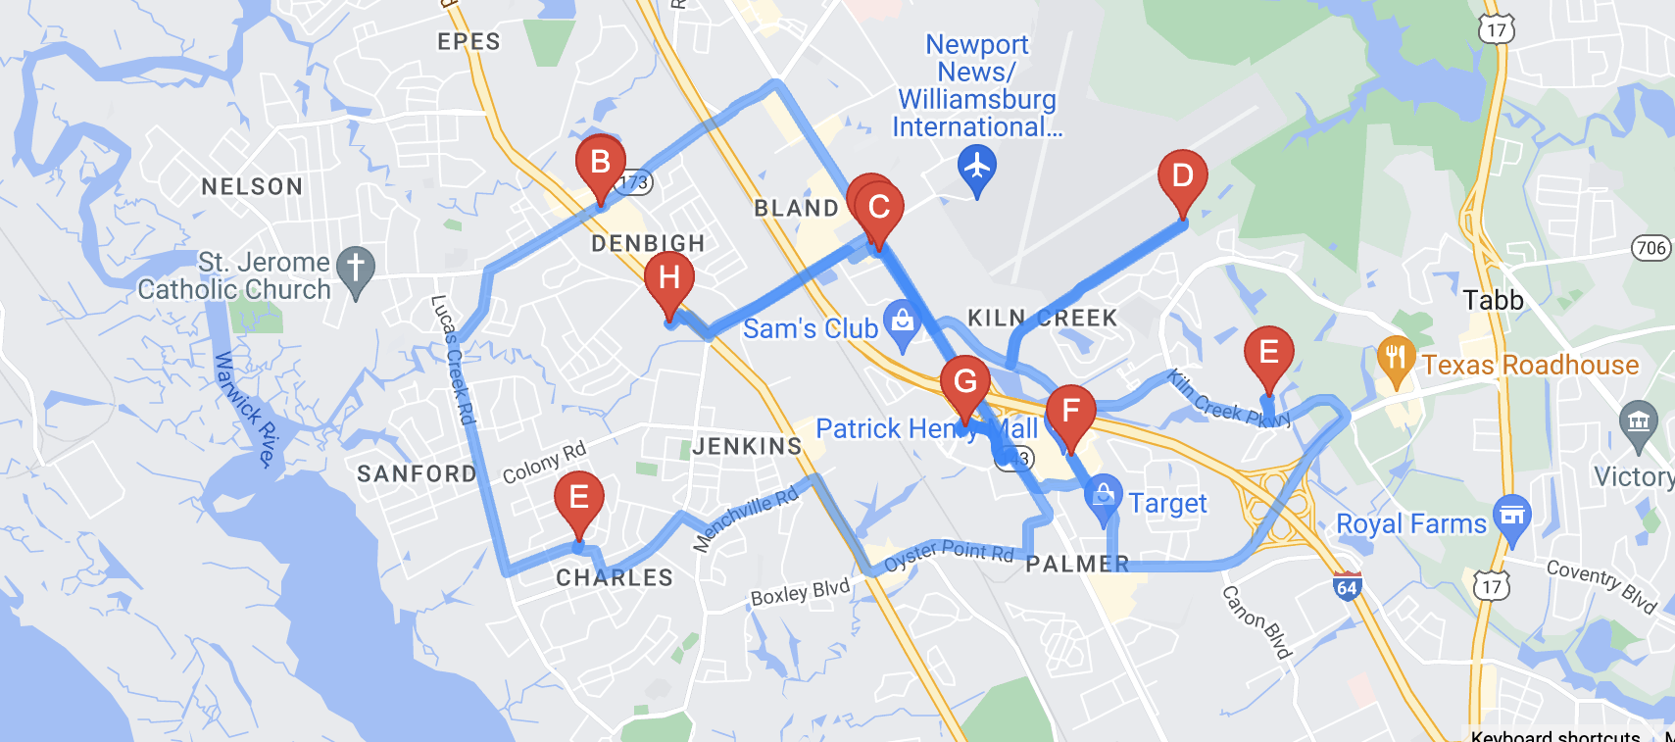
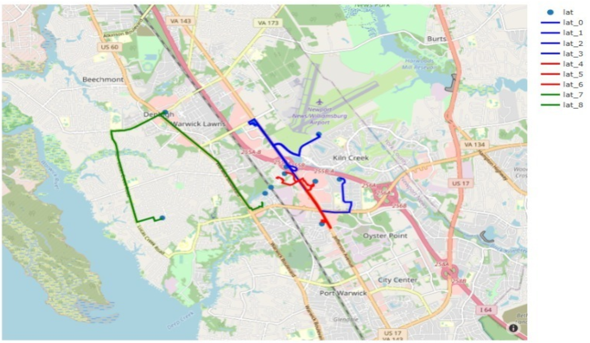
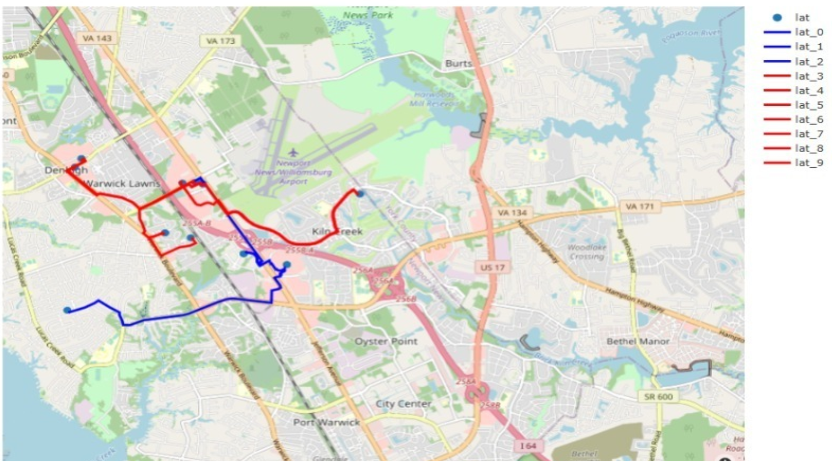
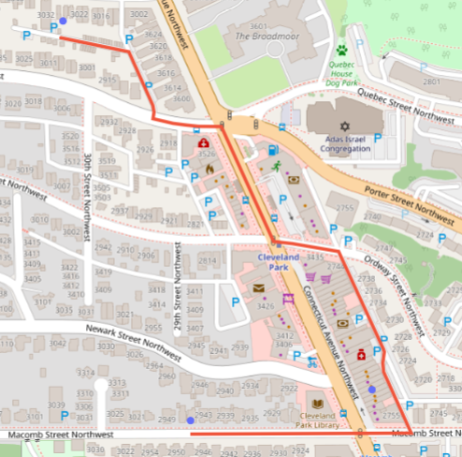
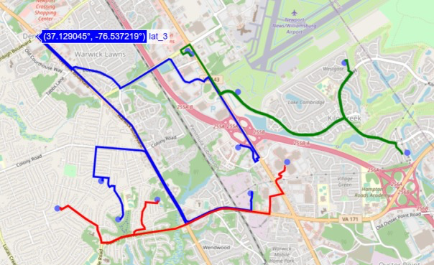
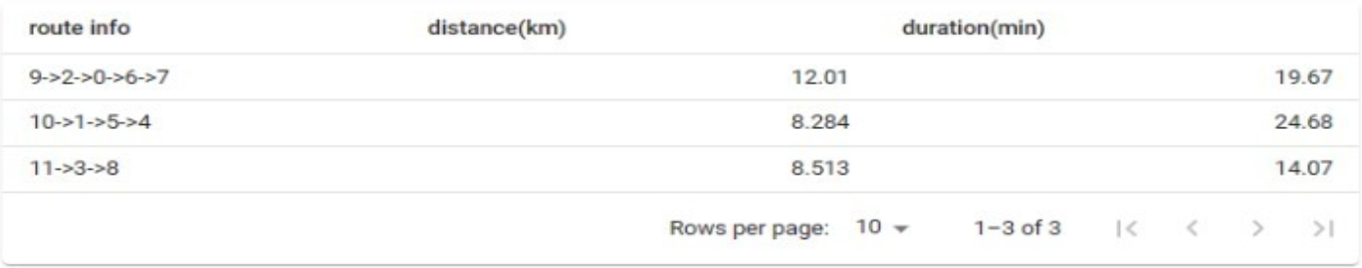
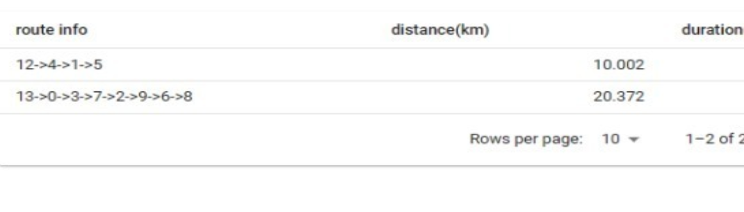
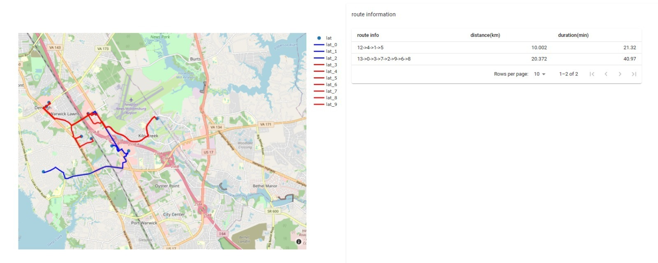
Developing Machine learning and Supply chain Application using Taipy
(Python Open Source Advanced Tools)
Team: Priestley Fernandes, Kavan , Kanika Yadav, Zhaoyi Xu, Richeng Zhang, Syed Qaderie, Rahul Sikinam
Instructor: Alkiviadis Vazacopoulos
Motivation
Integrate state-of-the art mechanism to enhance delivery system
Fast assignment of drivers to order efficiently 1) with lowest distance 2) time efficient
Using Taipy built an optimized efficient delivery system
Results
A map plot of the driver, restaurants and customers location on map
Assignment of driver to a order
Reduced Makespan
Optimized routes and total travel times and distances
Orders are delivered in sequence as per the optimized route generated, not necessarily at once
Plot of points:
Plot of routes:
Case1:
4 drivers, 5 orders and 4 restaurants→ 2 routes
Case2:
3 drivers, 5 orders and 4 restaurants → 3 routes
Experiment
Objective was to minimize the overall distance travelled by each vehicle
Built a Two Stage optimizer
Use of VRP tools ,Google API and openrouteservice api to solve the problem
Created Routes based on number of vehicles
Following cases considered:
Single order (k) – driver(m) mapping
Multiple order (k) – driver(m) mapped based on:
Vehicle capacity constraints
The capacity of vehicles is assumed to be 10 in our case. This case is usually applicable when rider has to pick up multiple deliveries along a route
Order Pick up and delivery locations
Restaurants are the pick-up points while customers are delivery locations. As per the algorithm they are randomly mapped. Multiple orders can be assigned to a single rider.
Number of vehicles
Different number of vehicles create equal number of routes or less. Number of routes are based on optimized routes.
Assuming the speed is constant, time is optimized automatically
Based on all constraints mentioned above, following are the results:
Conclusion
Quick implementation, effective and efficient way to leverage technology
Use of Google APIs and Taipy integration to solved VRP within short time span
Enhance model performance with use of OR tools and Taipy
Based on conditions routes can be optimized
Future Scope
Feedback loop that optimize the next assignment of driver to an order
Upscaling the model performance with large number of runs
Inclusion of additional risk factors or critical variables to consider
http://www.stevens.edu/bia

